Slide 1
Shell Bootcamp 2024 3 Reflections for Week 1
Ananya Mechineni
Date : 30-Aug-2024

Slide 2

About Me
“Continuous growth, endless possibilities.”

Slide 3

My learnings from this week!

Slide 4
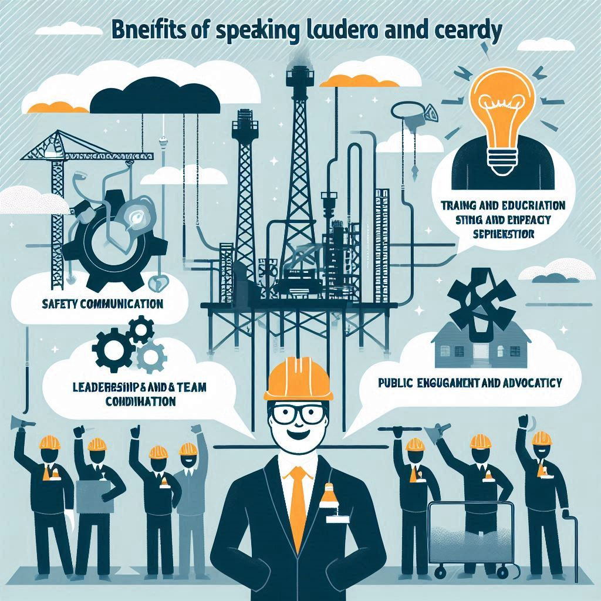
Learning 1 | My takeaways
Key learning
Speak Louder
Key takeaway
Speaking louder is a very crucial part for effective communication.
How do I personally see this concept implemented in the Energy sector
Speaking up can be helpful in the areas of safety ,leadership and public engagement

Slide 5
Learning 2 | My takeaways
Key learning
Professionalism with clients
Key takeaway
Maintaining Professionalism means communicating with the clients respectfully ,upholding integrity ,confidentiality and much more
How do I personally see this concept implemented in the Energy sector
It makes the requirements of the clients clear, helps maintain client-centric approach.

Slide 6
Learning 3 | My takeaways
Key learning
Etiquettes in an Organization
Key takeaway
Take away would be showing respect, fostering a positive and collaborative environment.
How do I personally see this concept implemented in the Energy sector
In energy sector it would be necessary for punctuality, safety and ethical conduct

Slide 7

Relevance of learnings for my organization

Slide 8
Learning 1 | Relevance for Shell
How I feel Shell implements this learning
Shell put a lot of focus on speaking your thoughts out, everyone’s ideas are taken into consideration.
How I feel Shell benefits from this learning
Shell benefits on this with employee engagement, better planning, more innovation, and better trust
[Add a graphic that provides view of how Shell implements this learning]

Slide 9
Learning 2 | Relevance for Shell
How I feel Shell implements this learning
Professionalism with clients at shell is through keeping the confidentiality of the clients , maintaining a sense of trust.
How I feel Shell benefits from this learning
Shell with professionalism benefits a lot throughout its operations as it makes transparent communication, client-centric approach and provides trust.
[Add a graphic that provides view of how Shell implements this learning]

Slide 10
Learning 3 | Relevance for Shell
How I feel Shell implements this learning
Etiquettes at shell is implemented through integrity ,honesty ,trust and respect for everyone
How I feel Shell benefits from this learning
Shell benefits from this with maintaining a ground level for everyone, creating its principles.
[Add a graphic that provides view of how Shell implements this learning]

Slide 11

Challenges in implementing learning

Slide 12
Challenge faced while implementing Learning 1
Challenges
Fear of Judgement
Lack of confidence
Hierarchy and authority
Plan To Overcome
Practice Active listening
Ask for feedback
Start small
[Add a graphic that provides evidence of what you did to overcome this challenge]

Slide 13
Challenge faced while implementing Learning 2
Challenges
Lack of experience
Communication skills
Understanding client needs
Plan to Overcome
Continuous learning
Mentorship
Professional development
[Add a graphic that provides evidence of what you did to overcome this challenge]

Slide 14
Challenge faced while implementing Learning 3
Challenges
Understanding professional norms
Time management
Adapting to corporate culture
Plan to Overcome
Observe and adapt
Be open minded
Engage in trainings
[Add a graphic that provides evidence of what you did to overcome this challenge]

Slide 15

Action Plan

Slide 16
My Action Plan for this Week
Actions
Timeline
Status
Research and practice on communication , how to speak in a organizational culture, and also engage with peers.
During this week and soft skills training
Have been working on all the lessons taught and have seen improvements

Slide 17

Learning is also Fun!

Slide 18
Learning is also Fun!
Learning is fun at Shell and with this soft skills training, there were a lot of peer to peer interactions, played bingo to engage with everyone, had individual and group presentations
Hade fun with the role plays
[Add a graphic or a picture of how you/your team enjoyed the new learning]

Slide 19

Summary
Quick summary
The week has been full of soft skills, communication ,interaction ,presentations and a short lesson on grooming.
Importance of topics of upcoming week
Upcoming week will be about technical training and about business analysis ,azure ,dbms
Connectivity of topics from current week
The communication and presentation skills learned this week will support effective collaboration and clear reporting in business analytics and Azure DevOps projects.

Slide 20
Thank You

